Slide 1
WEIMAR GERMANY
1918-1923
Background and early opposition to the Weimar Republic

Slide 2
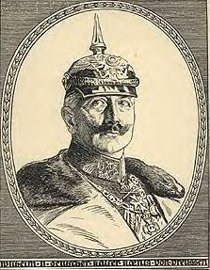
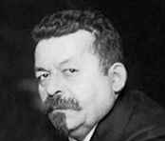
The Abdication of the Kaiser
“I’m off to Holland!”
In the final year of WW1 the people of Germany were living in terrible conditions. Starvation, hunger and poverty dominated the streets of the country. By November 1918, strikes and riots about such conditions left Germany in chaos. Without support, the Kaiser abdicated (gave up his throne) and went to Holland. Friedrich Ebert took control as he was leader of the Germanys largest political party.
“I’ll take over then!”
Friedrich Ebert

Slide 3
Hitler called the people responsible for the surrender as ‘NOVEMBER CRIMINALS’
and wanted REVENGE.
Hitler was absolutely furious and upset at the surrender. He compared the feelings of surrender to the grief of when his Mother died when he was young.
Many Germans were surprised and ANGRY about losing the war because they had been told that they were winning.
11th November 1918 Germany Surrenders

Slide 4
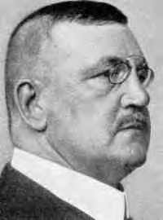

The Spartacist Revolt
Not everybody welcomed the new Government. Many, like the Spartacists led by Rosa Luxemburg, wanted massive changes in Germany by making it a Communist country. The Spartacists demonstrated against Ebert but he called out the troops and the demo ended. However, in January 1919 they tried to seize power in Berlin. Ebert needed the Free Korps (a gang of soldiers from WW1 led by Wolfgang Kapp) to destroy the Spartacists. A few days after their attempts, the Spartacists were destroyed and their leaders murdered.
Wolfgang Kapp (leader of the Free Korps)
Rosa Luxemburg
Opposition from the LEFT

Slide 5
Germany becomes a Republic
(A country without a King)
Germany became a Democratic country where for the first time in their history German people were allowed to vote for a Leader of Germany. In January 1919 the Weimar Republic was born.
WEIMAR REPUBLIC
(Many thought that Democracy would be a failure as Germany had always had a strong and powerful leader. When the Weimar Republic failed many liked the idea of Hitler being a strong and powerful leader – just like the ‘good old days’ when the Kaiser was in power.)

Slide 6
The Treaty of Versailles
(This created massive problems for the new Weimar Republic - See the Power Point on the Treaty)

Slide 7
Revolts in Berlin and Bavaria
Free Korps to the rescue…again!
Again, people showed they did not want the new Republic by trying to take over in Berlin and Bavaria. In Bavaria, a new republic was declared by Communists where houses and land were taken from the rich and given to the poor. However, Ebert had to rely on the Free Korps to destroy opposition.
Wolfgang Kapp (leader of the Free Korps)

Slide 8
The Kapp Putsch
The Treaty of Versailles ordered the reduction of the Army and it also told the Government to disband the ‘Free Korps’. Therefore, Ebert had no choice but to do exactly that. However, its leader (Wolfgang Kapp) decided to try and seize power by force (a putsch). Kapp had the support of the Army and the police and the putsch took place in March 1920 in Berlin.
However, the people of Berlin organized a General Strike and managed to save the Weimar Republic.
Wolfgang Kapp (leader of the Free Korps)
Opposition from the RIGHT

Slide 9
What comes next?
What exactly was the Treaty of Versailles and how did Germany react to it?

